Slide 1
CSBS Internships
https://internships.csbs.utah.edu/

Slide 2
What is an internship?
An internship is a form of experiential learning that integrates knowledge and theory learned in the classroom with practical application and skills development in a professional setting. Internships give students the opportunity to gain valuable applied experience and make connections in professional fields they are considering for career paths; and give employers the opportunity to guide and evaluate talent.

Slide 3
What are the benefits of an internship?
Potential college credit – internships can support a quicker path to graduation.
Students gain valuable experience in the field they may be interested in a career in.
Students make professional connections in the job market.
Students gain experience with applying/interviewing/resume/cover letters.
Students feel overall more comfortable in their majors.

Slide 4
Steps to finding an internship
Start with CSBS database: https://internships.csbs.utah.edu/students/internship-opportunities.php
The database is a compiled list of preapproved internship sites that the university has formerly had interns at or has a relationship with. Opportunities at each listed site may vary from semester to semester, so make sure to check what’s available
Filter by major
Look through organizations listed
Discover opportunities you may be interested in
Apply based on instructions per internship site

Slide 5
Getting credit for an internship
Make sure to have an internship formally set up
Calculate number of credit hours able to be earned based on hours worked per week (dependent on major, credit information can be found on the internships website)
Fill out internship approval request form: https://csbsutah.co1.qualtrics.com/jfe/form/SV_0CCFGYDqkRHCcl0
Departments will either approve or reject based on how the internship relates to the major/to coursework/to career goals
Jacqueline Broida will contact student with a permission code to add the course

Slide 6
Services we provide
We are happy to help with applications and anything else you might need to be successful in securing your own internship
Academic advising – see Internship Program Advisor’s contact on next slide
International student advising
Justice Advocacy Fellowship advising
Resume/cover letter help
We also offer referrals to other campus resources as needed

Slide 7
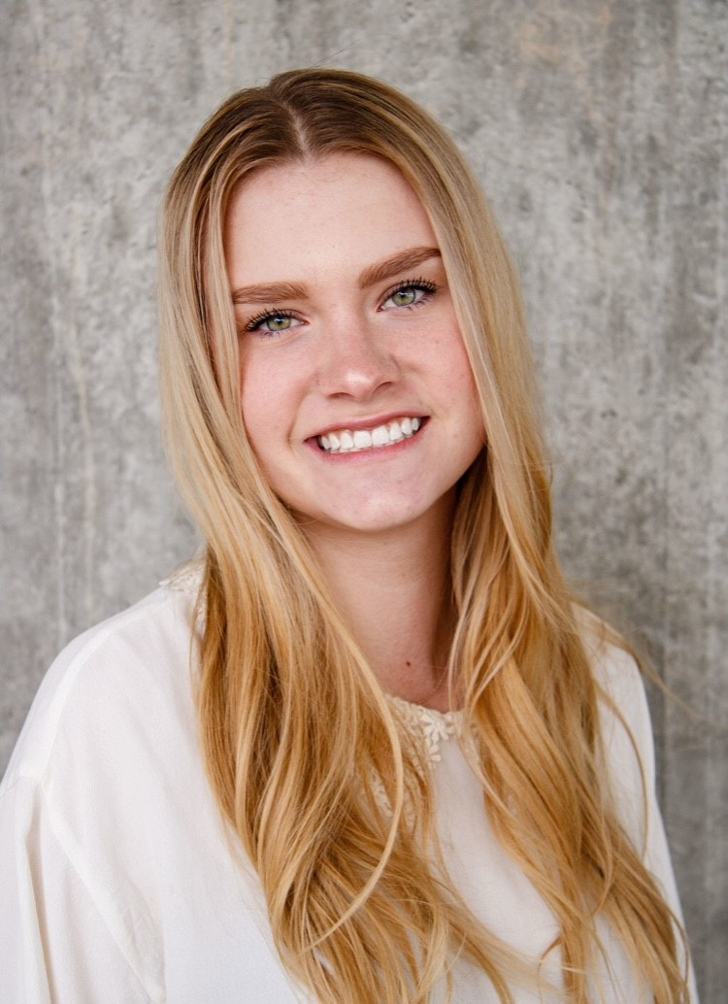
Contact
Sarah Frederick
Advisor, Internship Programming
College of Social and Behavioral Science
Email: sarah.frederick@csbs.utah.eduTel: 801-585-2003
Make a student appointment: https://outlook.office365.com/owa/calendar/Internships1@UofUtah.onmicrosoft.com/bookings/

Slide 8
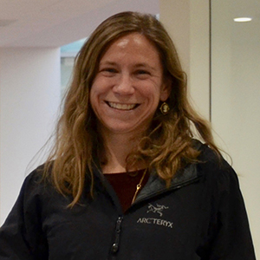
Contact
Jacqueline Broida
Associate Director, Internship Programming
College of Social and Behavioral Science
Email: jacqueline.broida@utah.edu
Tel: 801-587-7359
Make a student appointment: https://outlook.office365.com/owa/calendar/Internships1@UofUtah.onmicrosoft.com/bookings/

